Slide 1
Meter Seal Tracking
Centralize Solution for Meter Seal Tracking

Slide 3
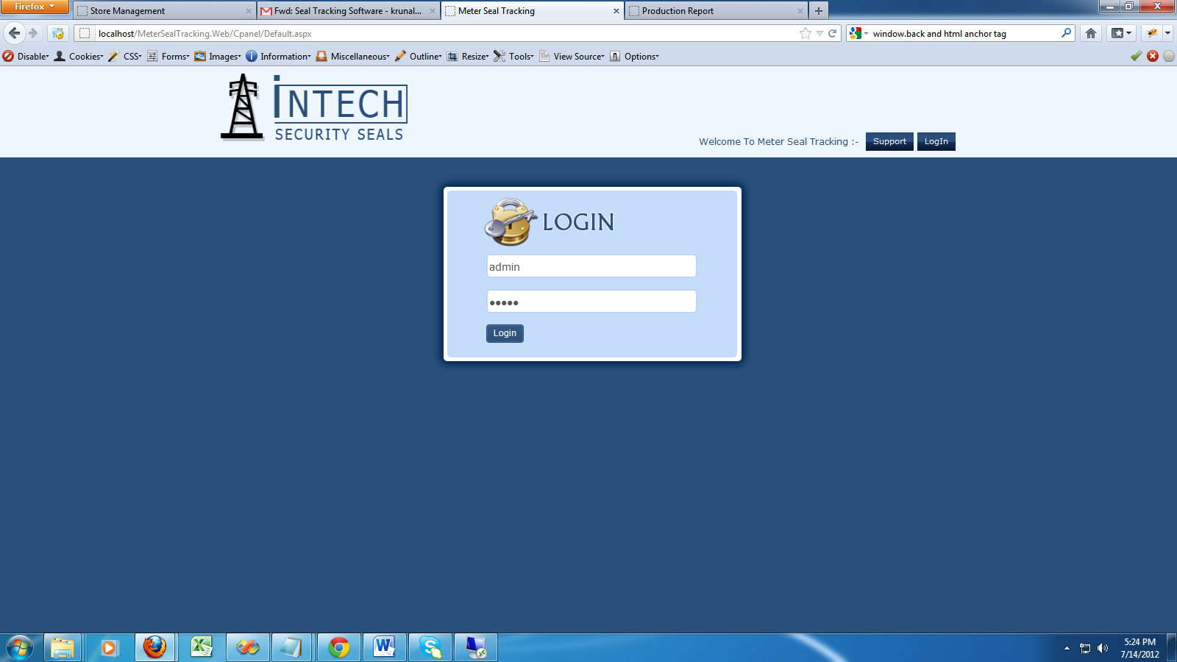
Login Page

Slide 4
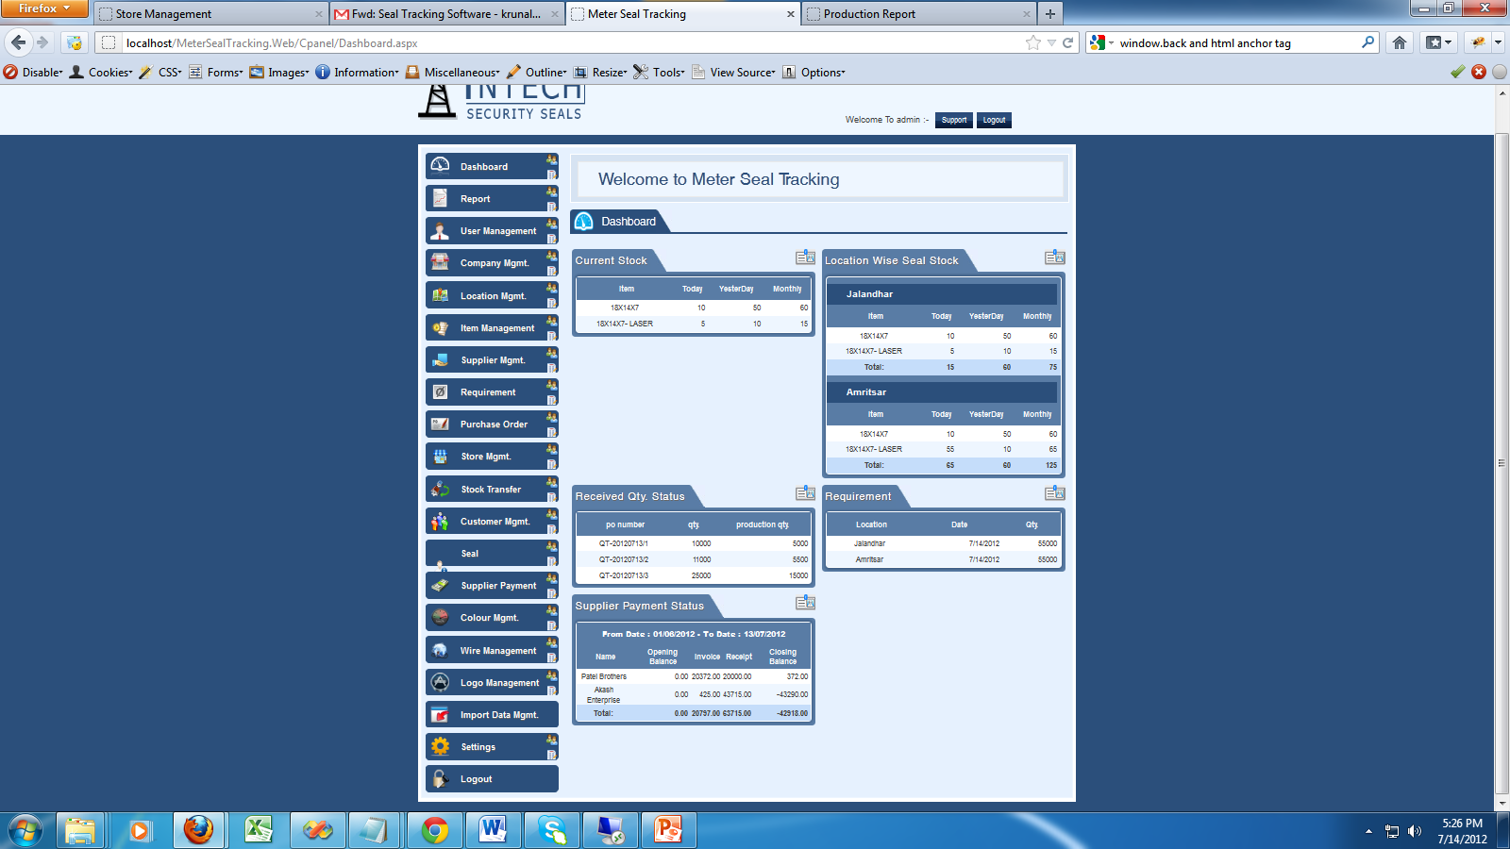
Dashboard

Slide 5
Dashboard – Summary of current Month
Display Current Stock of Seal
Display Current Stock of Other Item like Meter, Wire…etc
Display Location Wise Stock
Display Received Seal Quantity Status
Display Requirement of Seal as per Location Wise
Display Supplier Payment Status – this is only for Admin Person

Slide 6
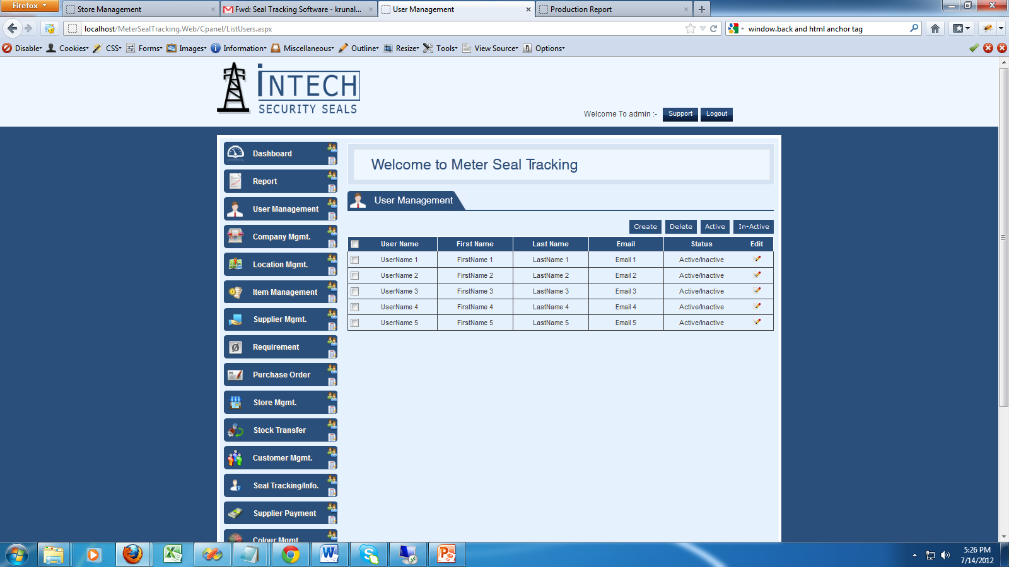
User Management

Slide 7
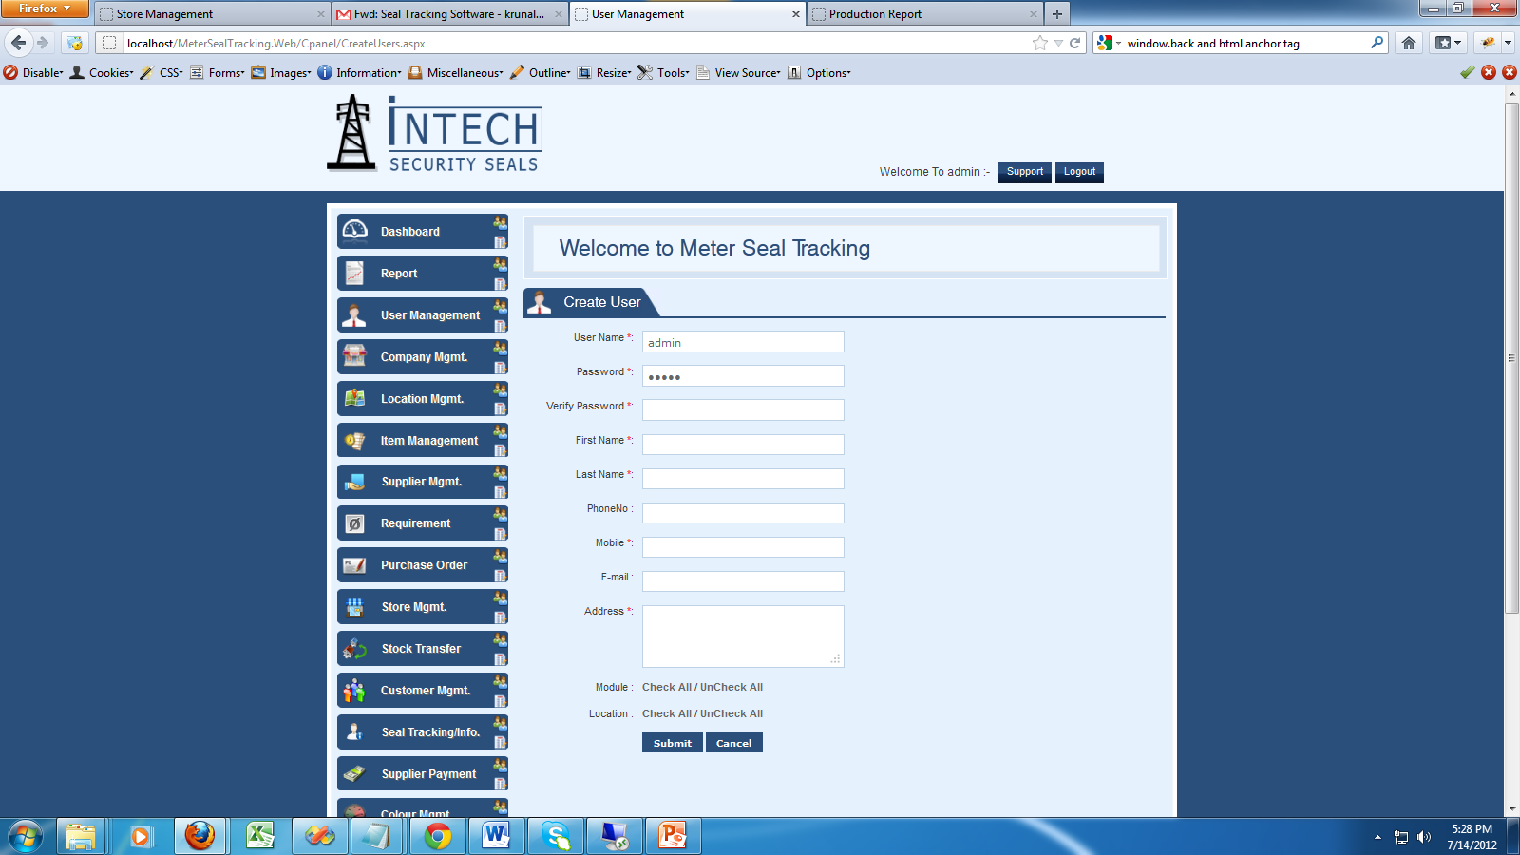
Create a New User

Slide 8
User Management
Create a new User as per Location wise
Also Give a Access as per Module and Location wise
Suppose create a one user like Jayesh and give a access of Patiyala Location then he can only view of Patiyala Status
Also Active and Inactive Facility. Admin User can Inactive of his/her account so they user can not login again to system.

Slide 9
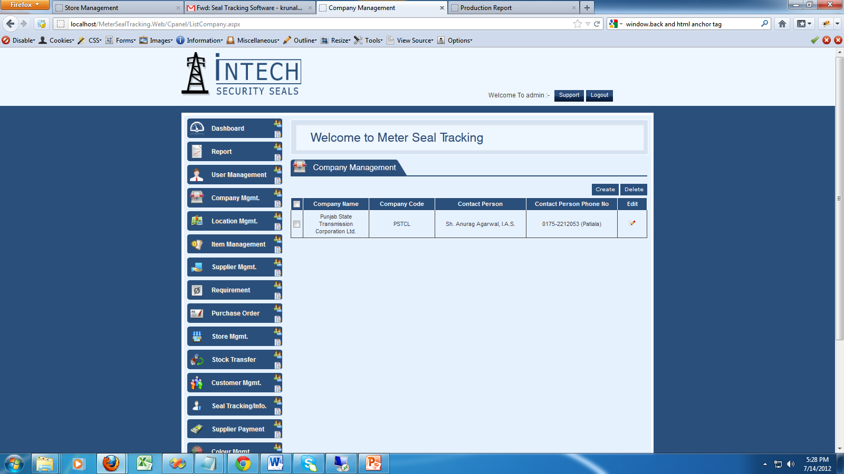
Company Management

Slide 10
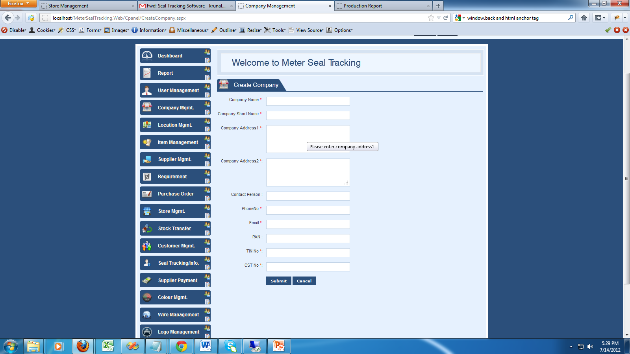
Create a New Company

Slide 11
Location Management

Slide 12
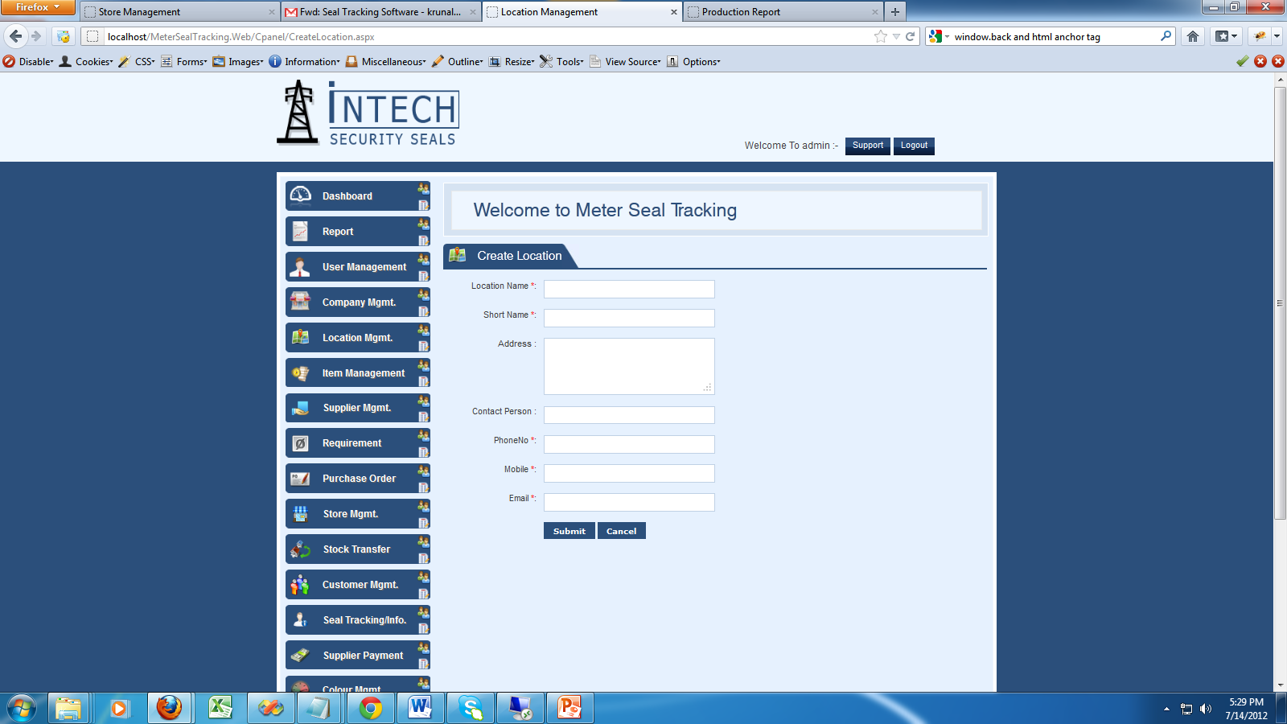
Create Location

Slide 13
Company Detail
Enter your Company Detail like Address and contact Detail. So Automatic display in Purchase Order and other

Slide 14
Item Management

Slide 15
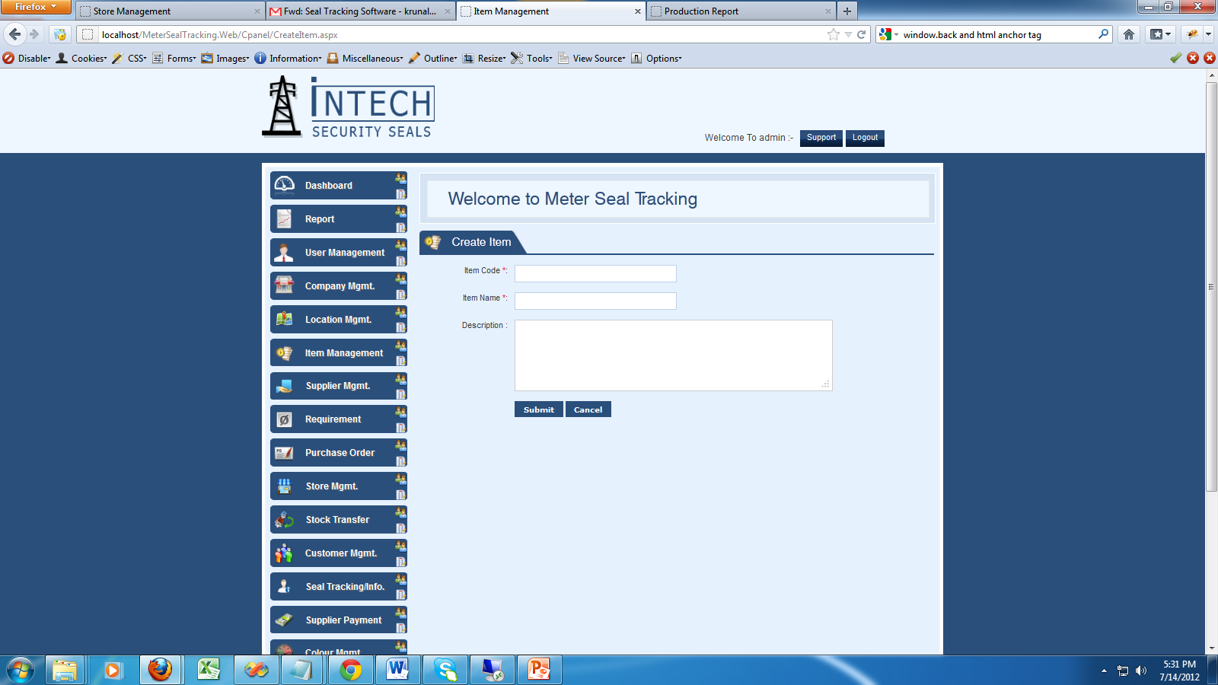
Create Item

Slide 16
Item Management
You can create a any item like Seal, Wire….Etc
This is use for Inventory System
Admin user or Other Manager can track regarding the item like seal, wire and etc…
Also User can enter the Previous Stock regarding the Item
Also You can Import the date using excel file

Slide 17
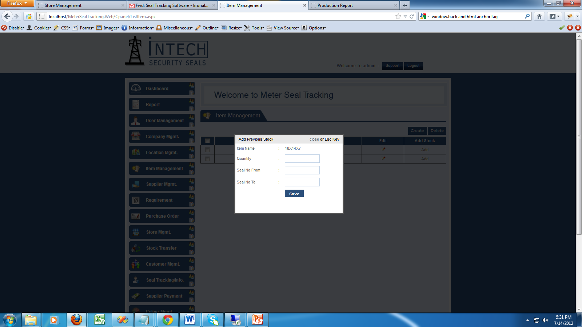
Add Item stock

Slide 18
Supplier Management

Slide 19
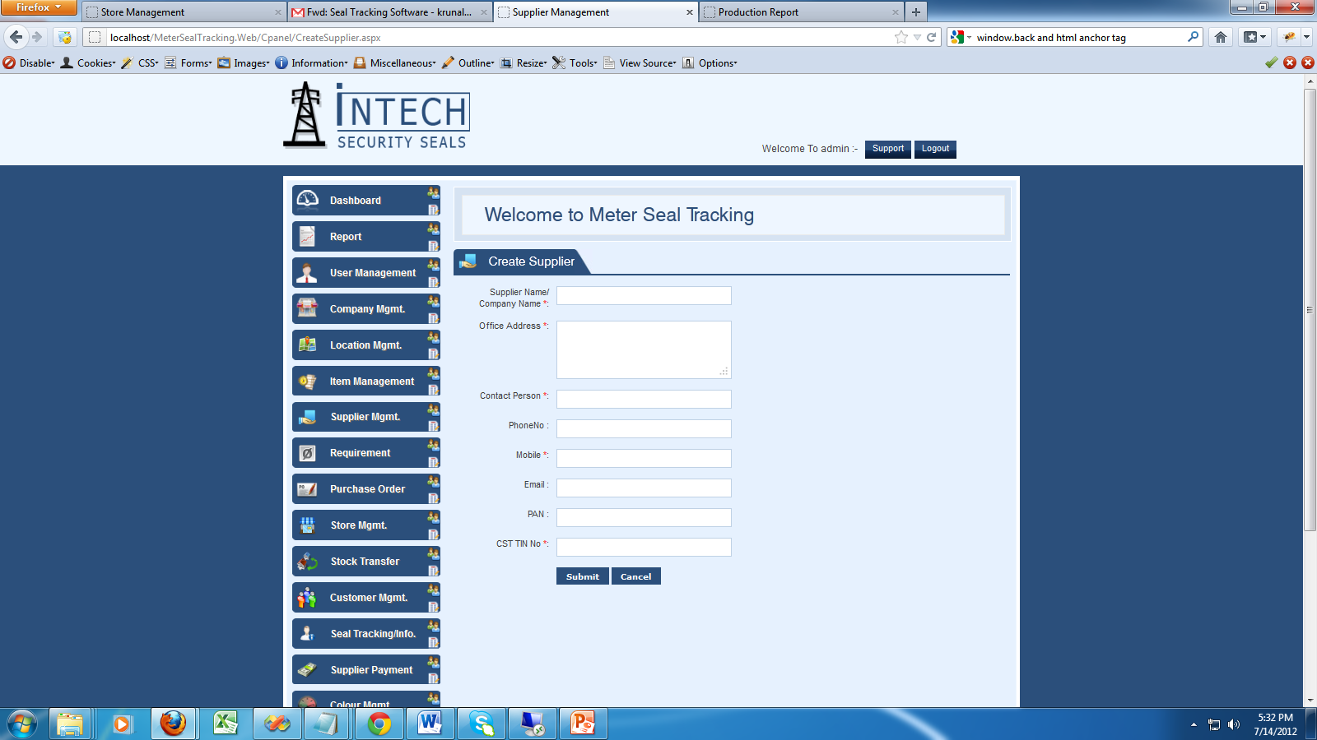
Create a Supplier Detail

Slide 20
Supplier Detail
You can Maintain your Supplier Detail
You can also take a print out and check it any time.

Slide 21
Requirement Management

Slide 22
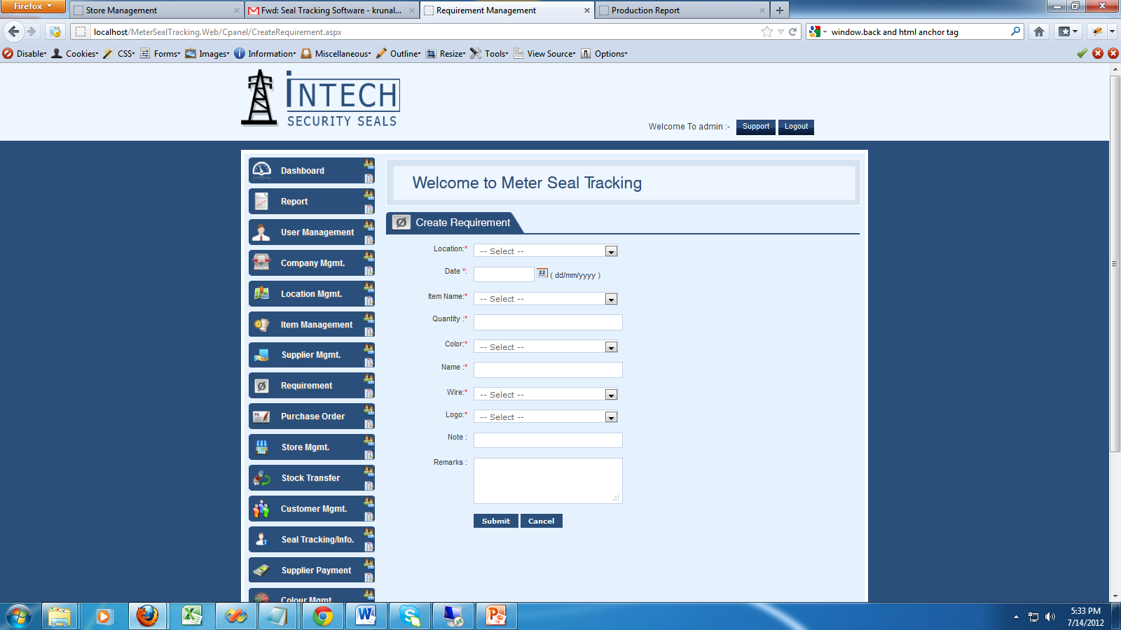
Create a new Requirement

Slide 23
Requirement
Location wise create a requirement regarding the material like seal and other items
Admin User or manager can view the requirement and approve it
Manager can generate the Purchase Order base on requirement and assign to any supplier
Also take a print out of Requirement and export in excel

Slide 24
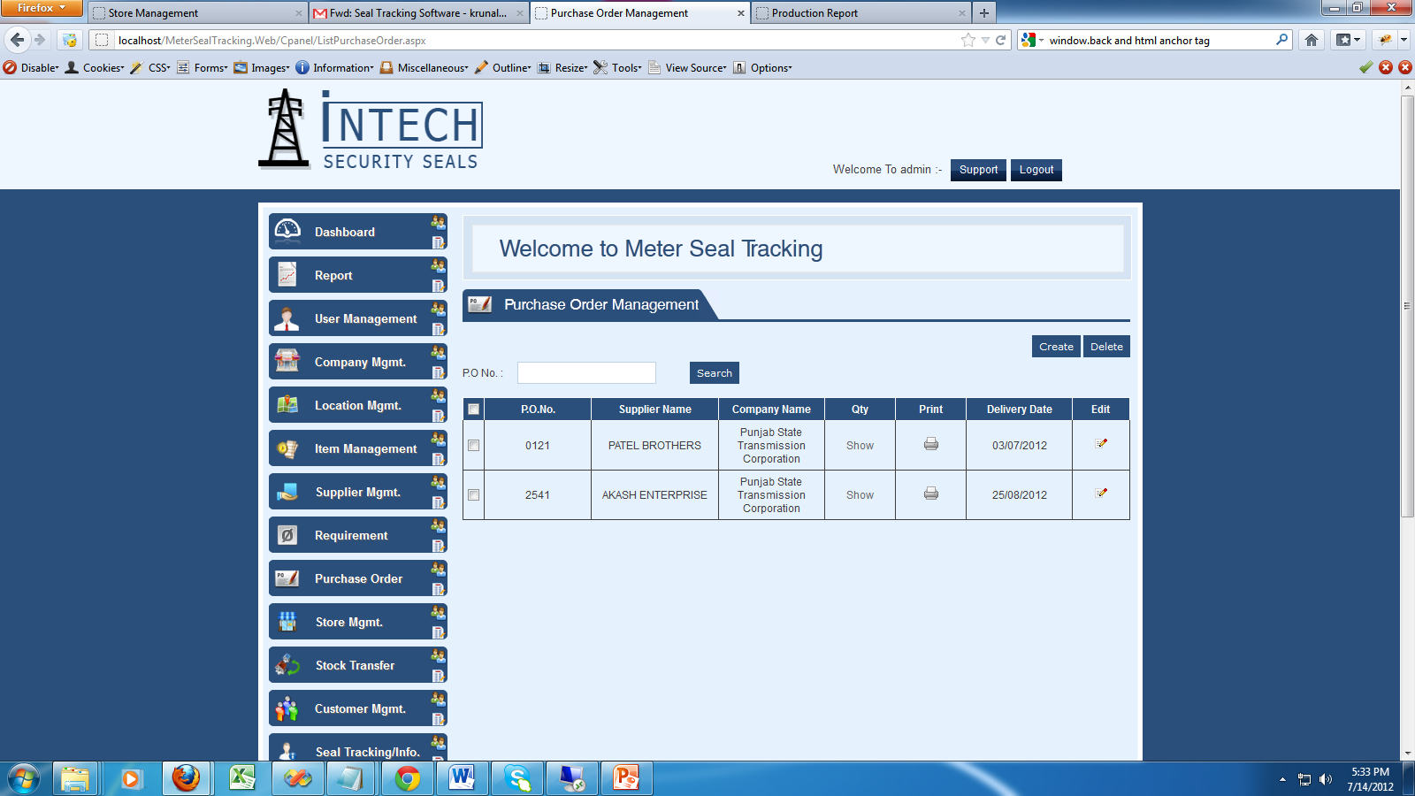
Purchase Order (PO)

Slide 25
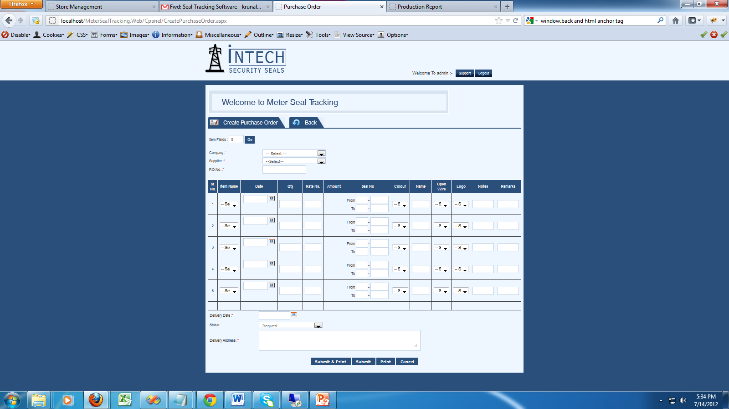
Create a new Purchase Order

Slide 26
Purchase Order

Slide 27
Purchase Order
User can create a PO base on requirement and take a print out on latter pad and also in simple paper
Admin User can see the PO (Purchase Order) detail and edit it and approve it
Print out and export to excel also possible.
Admin User also see the using his Phone and laptop

Slide 28
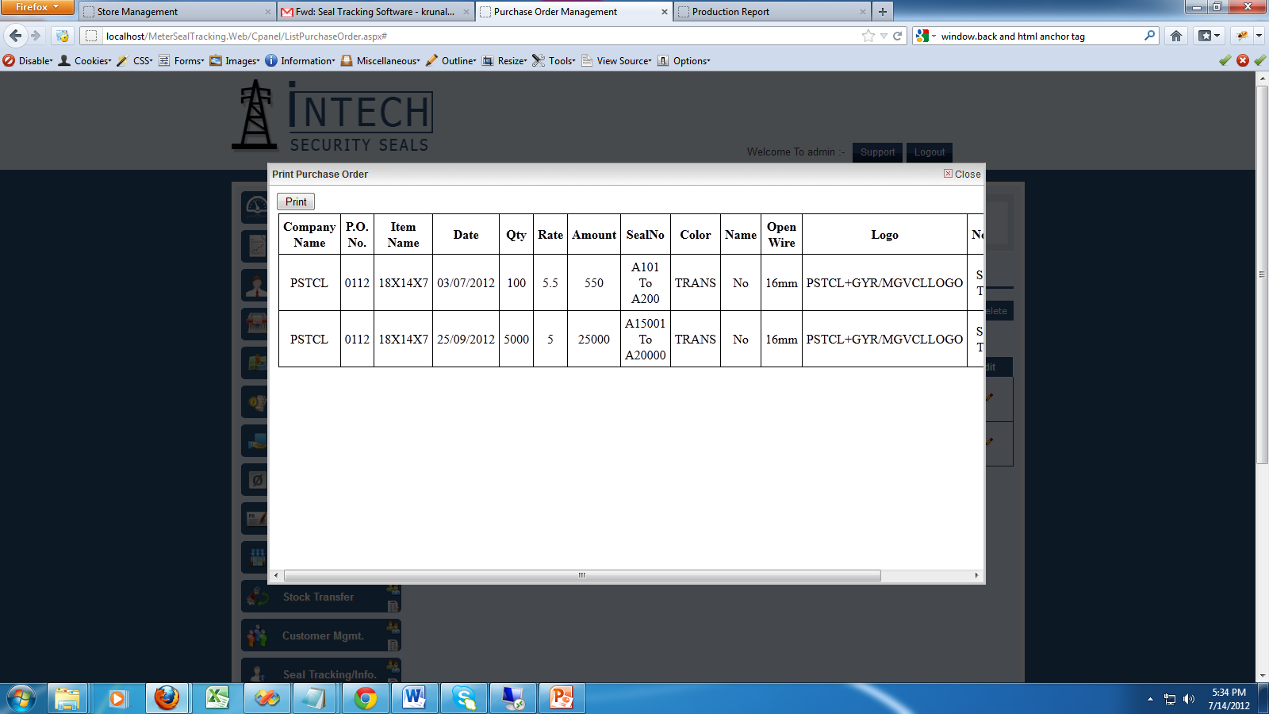
Purchase Order Detail

Slide 29
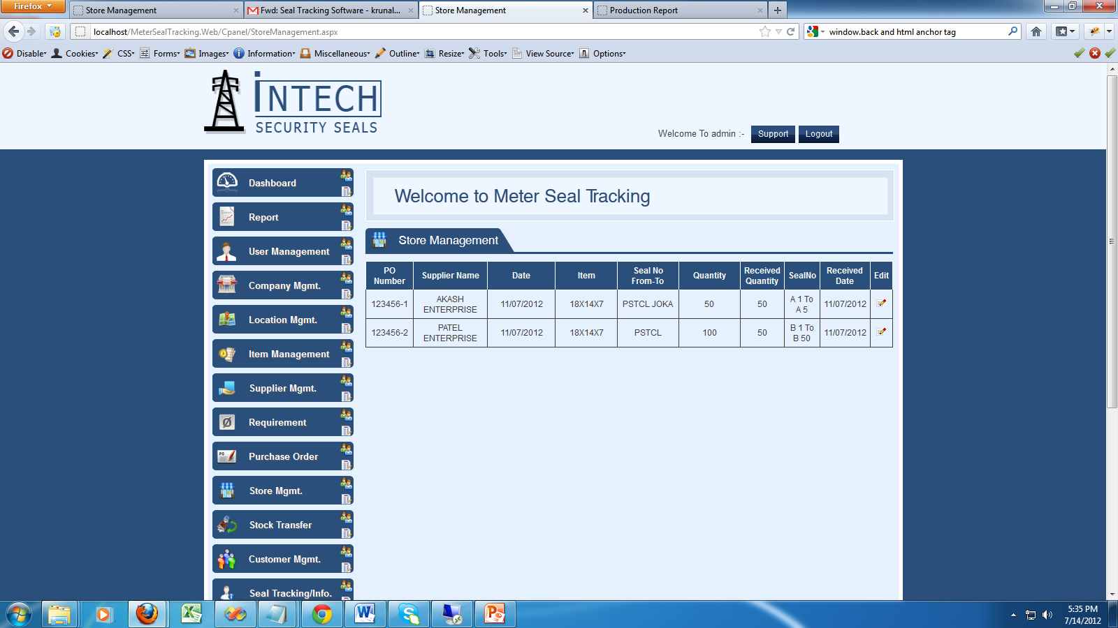
Store Management

Slide 30
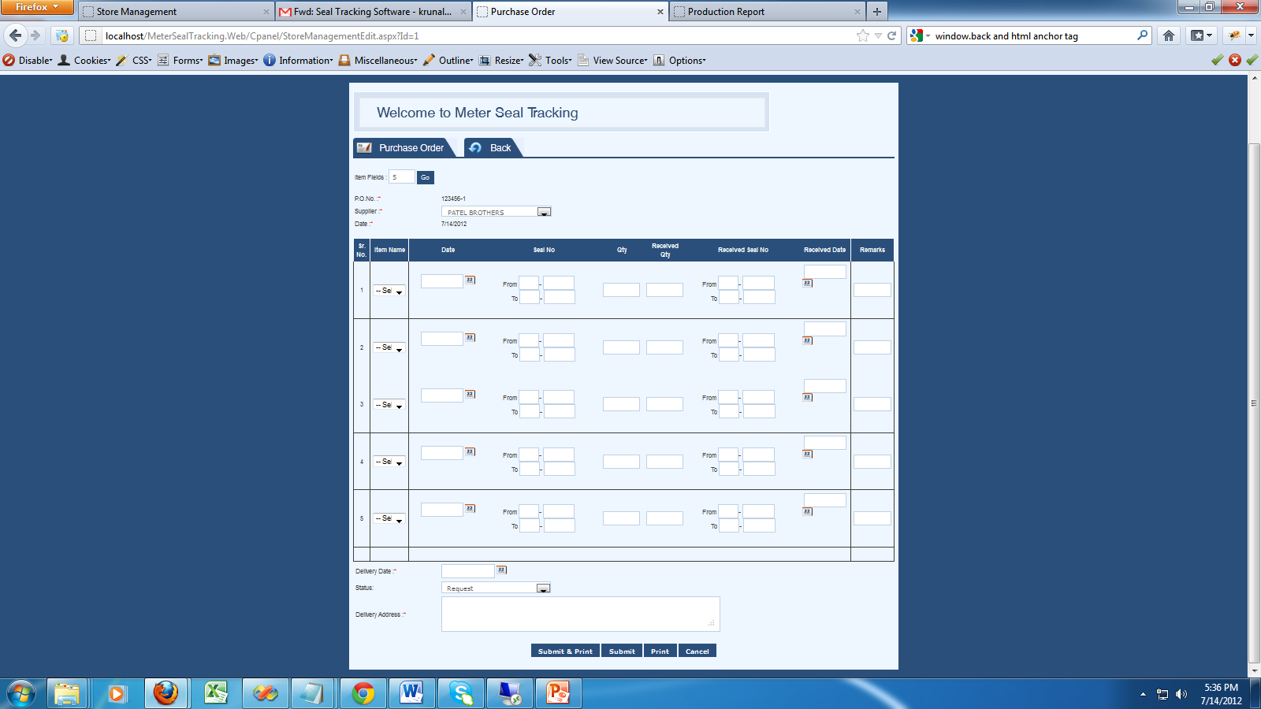
Edit Store Management

Slide 31
Store Management
User can enter the receive Quantity and maintain the data regarding received QTY. Which is given by supplier
Admin User can check any time regarding Stock Detail also display in Dashboard.

Slide 32
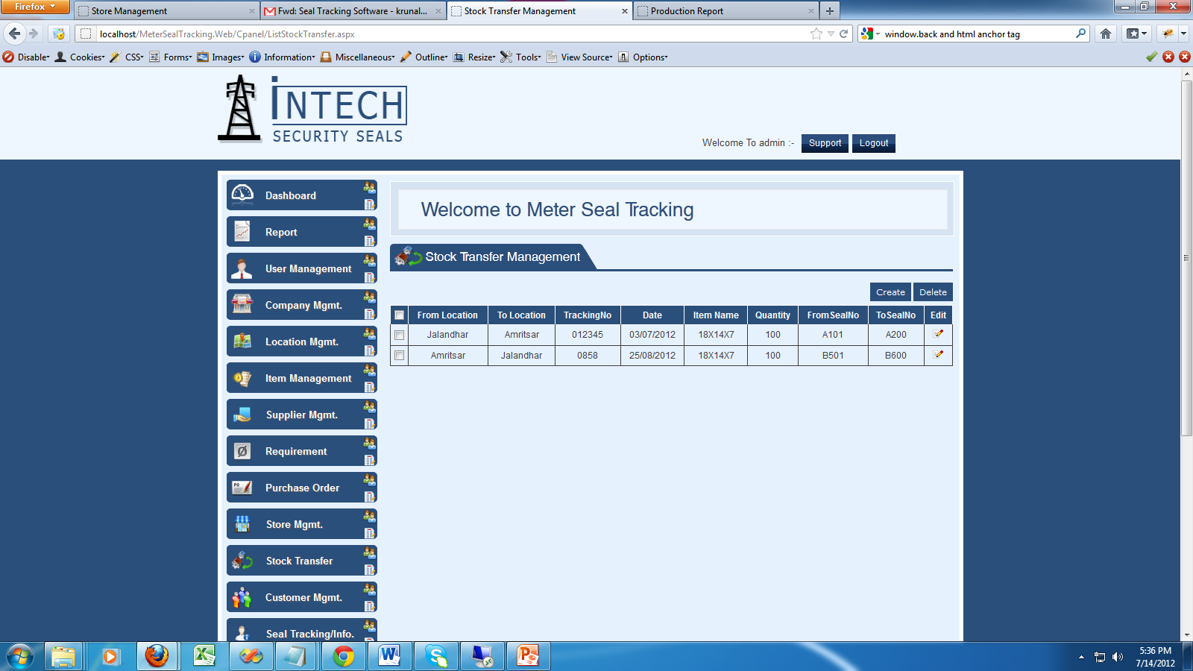
Stock Transfer

Slide 33
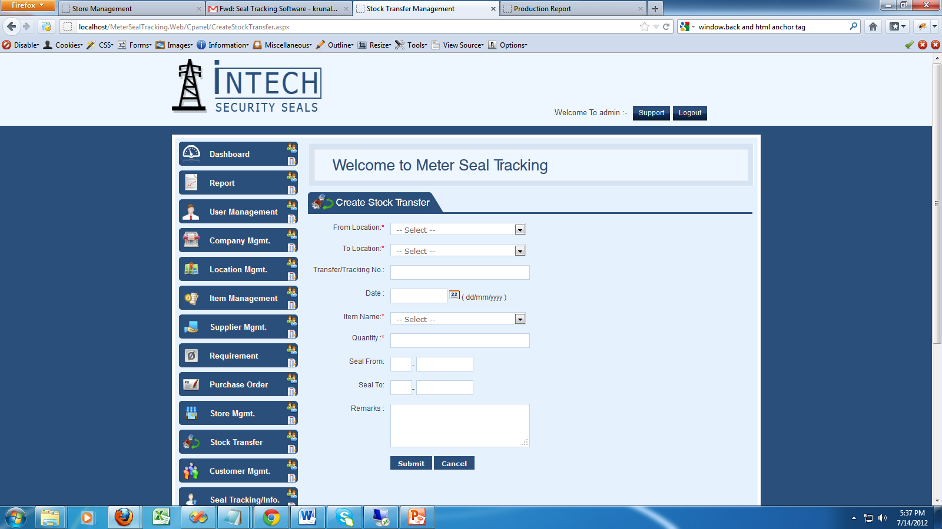
Stock Transfer Detail

Slide 34
Stock Transfer
Transfer seal one location to another location. Admin User can maintain the stock and get a proper information regarding seal.

Slide 35
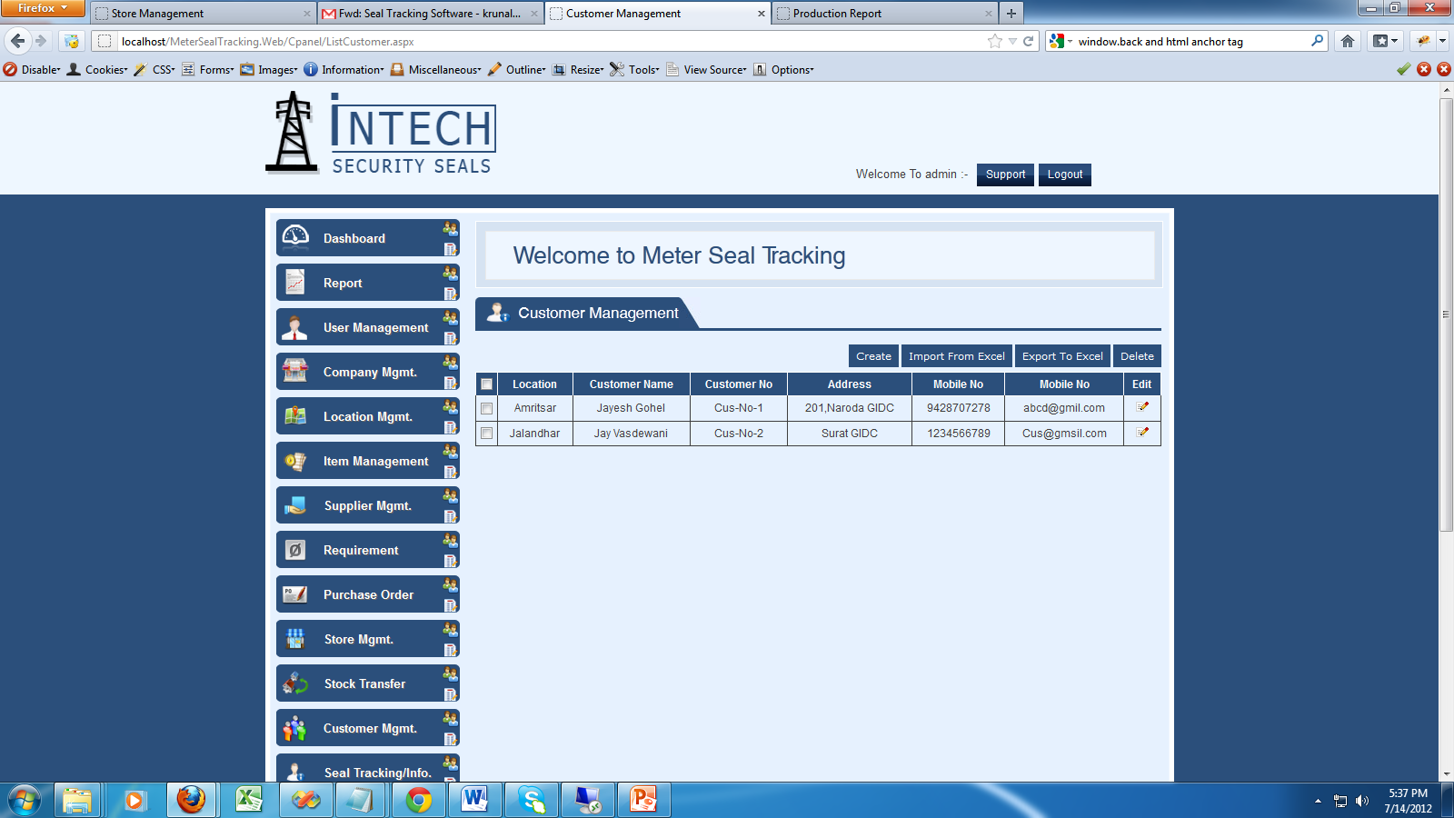
Customer Management

Slide 36
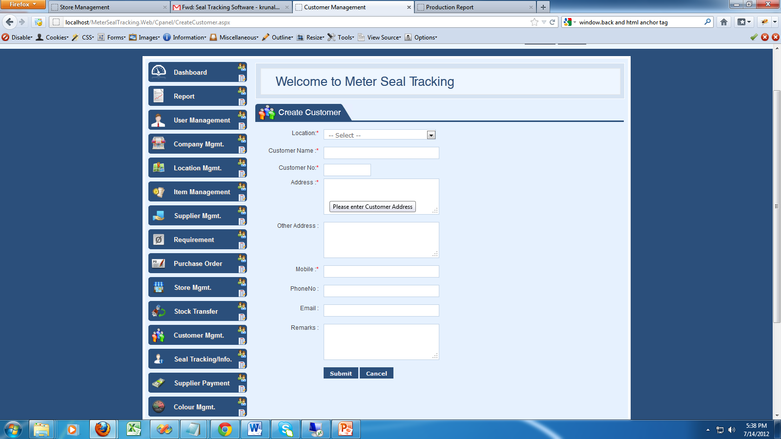
Create a new Customer

Slide 37
Customer Detail
Create a customer detail. This is a master regarding Customer as per Location wise.
We can import data using excel file
We can export data in excel.

Slide 38
Seal Tracking Information

Slide 39
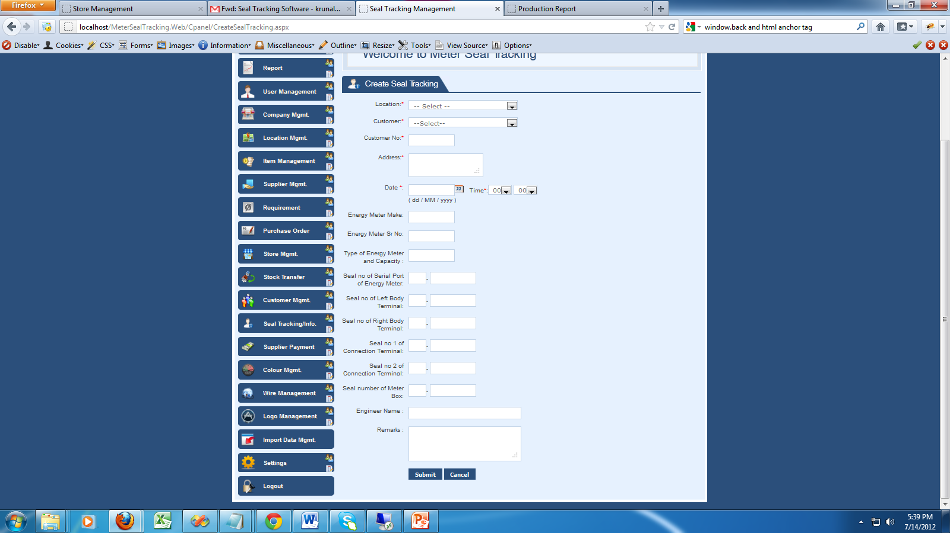
Create Seal Tracking

Slide 40
Meter Seal Tracking
Enter the detail regarding customer or import the detail of customer..
Enter the detail regarding which seal no attached with which customer and we can track any time.
Also available the report regarding seal detail.
Also display in Dashboard page or summary page.

Slide 41
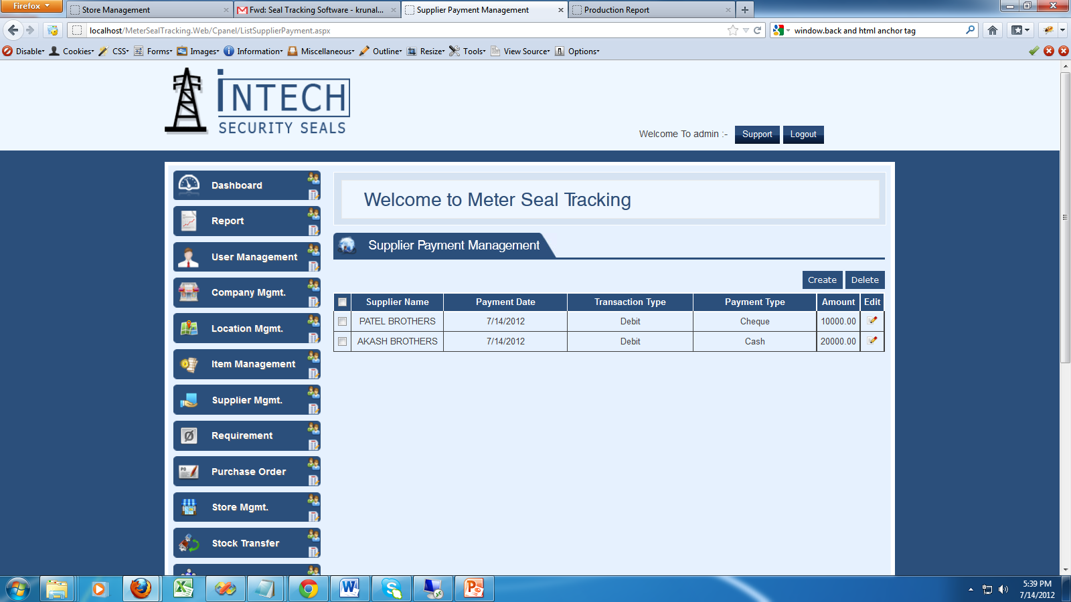
Supplier Payment Management

Slide 42
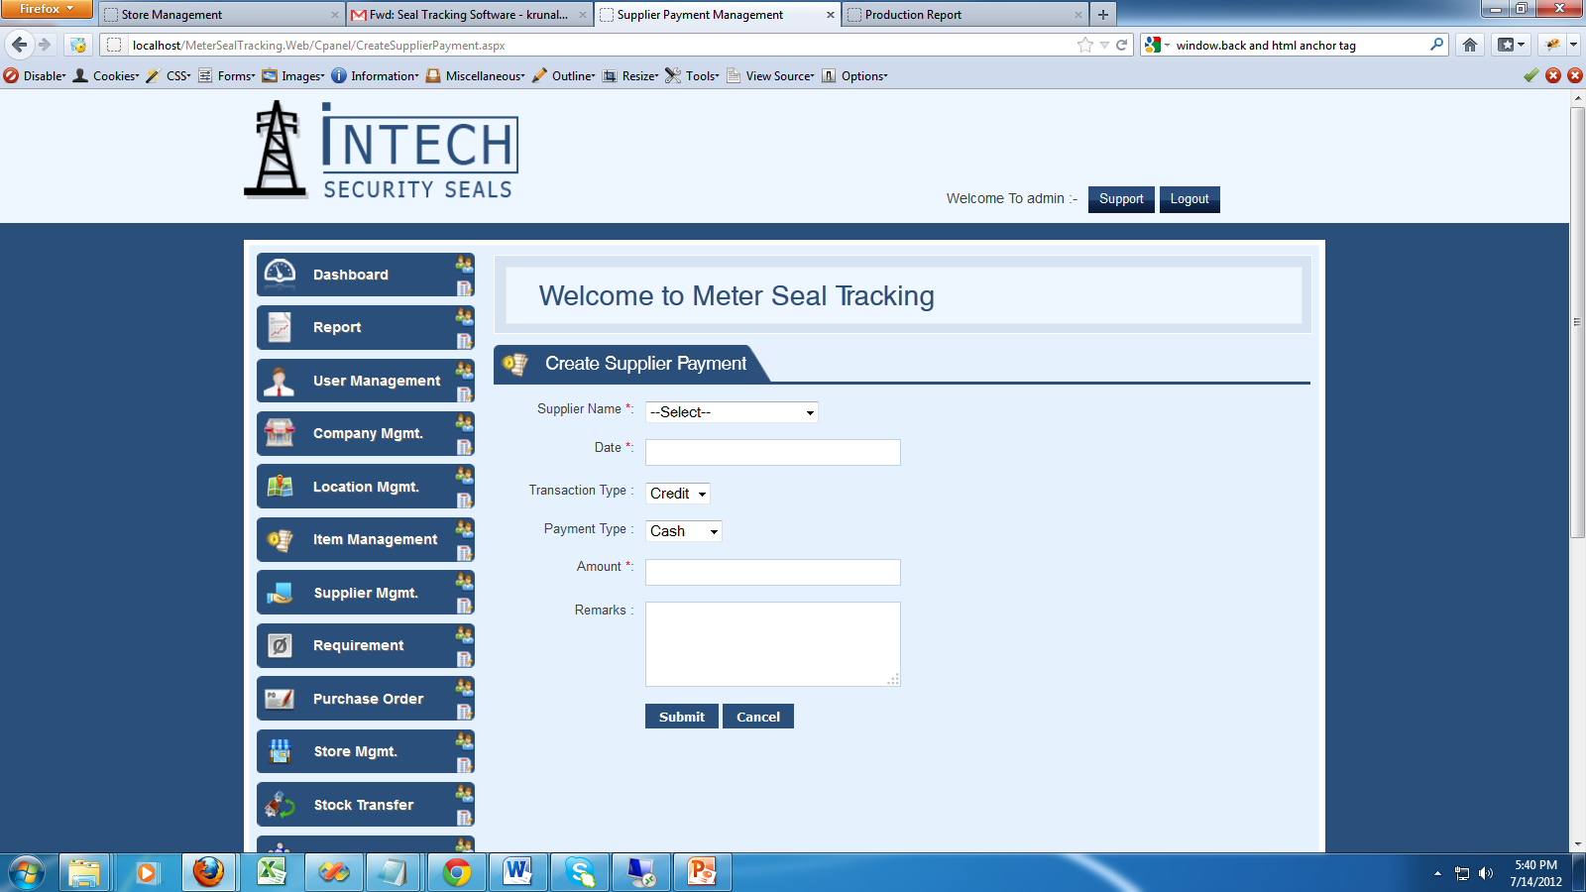
Create Supplier Payment

Slide 43
Supplier Payment Detail
We can manage the supplier payment detail. So we can get ledger any time of that supplier.
We can also take a print out of it.
We can also export into excel.

Slide 44
Report

Slide 45
Location Wise Seal Stock

Slide 46
Seal Tracking Report

Slide 47
Location Wise Seal Requirement

Slide 48
Received Seal Quantity

Slide 49
Supplier Ledger Report

Slide 50
Customer Report

